Slide 1
FROM INDUSTRIE 4.0 TO THE FOURTH INDUSTRIAL REVOLUTION
Shuo-Yan Chou, Ph.D.
Director of Center for Internet of Things Innovation (CITI)
Distinguished Professor of Industrial Management
National Taiwan University of Science and Technology

Slide 2
SOCIAL ECONOMIC DRIVERS
Lack of Skilled
Workforce
Aging Society
Later Retirement
Mass Customization Low-volume (1) High-mixture Factories
Urbanization and Clean Urban Production
Excess or Idle Physical Capacity Utilization
Environmental and Over-Production
Pressure
Shorter Product Lifecycles
Increasing Product Variability
Source: Wolfgang Wahlster, DFKI, Germany

Slide 3

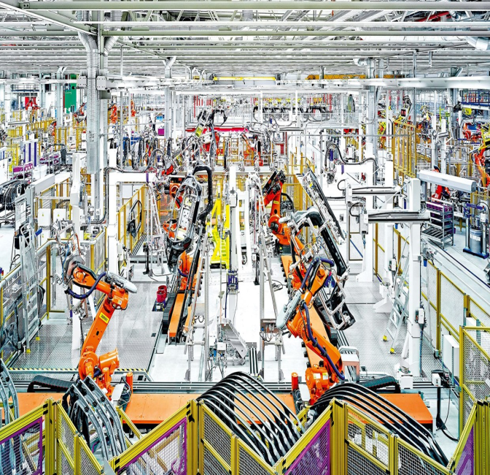


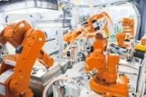
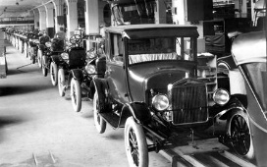
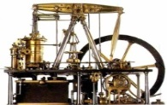






INDUSTRIAL REVOLUTION
FOURTH
THIRD
SECOND
FIRST
SMART FACTORY
MASS PRODUCTION
AUTOMATION
MECHANICAL PRODUCITON
INDUSTRIE 4.0
Cyber Physical System (CPS)
Internet of Things (IOT)
Internet of Services (IOS)
INDUSTRIAL INTERNET
Electricity and Division of Labor: Conveyor Line
Electronics and Info Technology: PLC, MES, ERP
Steam Engine
INDUSTRIAL
REVOLUTIONS
Notes:
Industry 4.0 is a vision, providing a direction and drive for industries towards the Fourth Industrial Revolution.
Not only on the efficiency of the production, which were achieved through Mass Production.
Productivity/performance improvement come from connectivity and collaboration, which result in flexibility (removing constraints) in the system.
Why now? (1) Moore’s Law makes it possible. (2) People are doing it now.

Slide 4
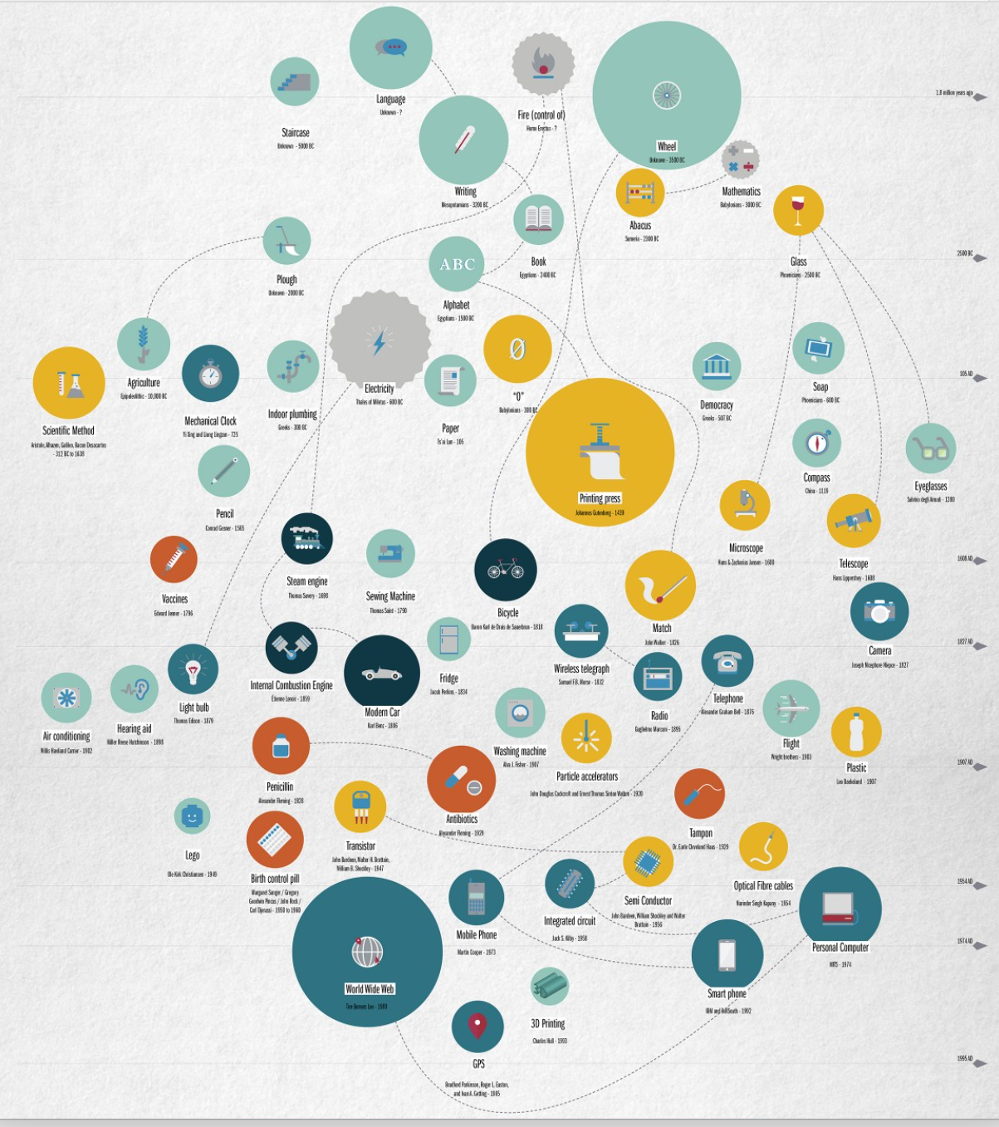
GREATEST INVENTION
Source: The Greatest Inventions of All Time, Racondeur, 2015
Notes:
Time and Space compression

Slide 5








EVOLUTION OF CONNECTIVITY
INTERNET
WORLD WIDE WEB
SEMANTIC WEB
Computer
Computer
Page
Page
Data
Data
INTERNET OF DISTRIBUTED, AUTONOMOUS THINGS
INTERNET OF THINGS
BLOCKCHAIN
+
Things
Things
Value
Value
Notes:
Internet/WWW is a passive system whereas IOT is an active system.
Blockchain build up trust in Internet. It is not a new function on Internet. It is a new Internet of money, value and ownership in all forms. – Lykle de Vries

Slide 6
















Common Technology
Application
Layer
IoT Applications
Food Pedigree
Hazard Mitigation
Smart Grid
…….
ITS
Tele-HealthCare
SERVICE
Intelligently
ID
Synthesis
IoT Application Support Layer
Public
Middleware
Open Message Platform
Cloud Computing Platform
Service Support Platform
IOT ARCHITECTURE
Network
Layer
Mobile IoT, IoT Integrated with Other Networks
Security Technology
CONNECT
Anytime
Hetero-network Integration
Resource And Storage Management
Dedicated Network
Remote/Distance Control
Next-generation Carrier Network
Mobile Communication Network
M2M Wireless Connection
Internet
QoS
Management
Communication and Sensor Layer Connection
Sensing
Layer
Sensor Network and Collaborative Message Processing
LPWAN
MEMS
Low-Far Medium-High Speed Short-ranged Communication Tech
Self-organizing Technology
Collaborative Data Processing
Sensor M/W Technologies
SENSE
Anywhere
Network Management
Data Acquisition
Sensors
Barcode
Rfid
Multimedia
Notes:
Break Spatial-Temporal Barriers
Seamlessly connecting physical and digital world.
Body Area Network (BAN); Personal Area Network (PAN); Controller Area Network (CAN); Local Area Network (LAN); Wide Area Network (WAN)

Slide 7

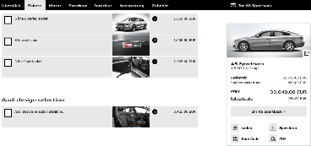



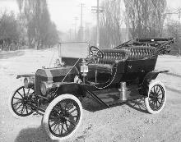
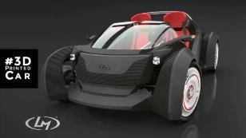
IMPLICATIONS ON PRODUCTION AND SUPPLY CHAIN PROCESSES
VW Beetle
Production
1955
Audi Configurator
Production Volume per Variant
1980
Mass
Production
Shared Economy
Mass Customization
Globalization
2000
iPhone
1913
Complexity
Individualization
Manual Shop Production
1850
Ford Model T
3D Printed Car
Source: Fraunhofer IPA, IFF Universität Stuttgart
No. of Variants

Slide 8
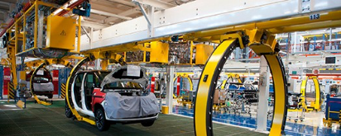
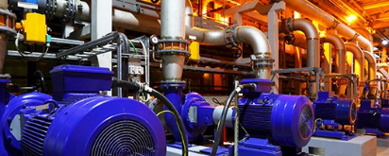
WIRELESS SENSING, CONNECTED SMART ENVIRONMENT
CRITICAL ISSSUES:
Identification
Sensing or Data Acquisition
Wireless Communication
Low Energy
Energy Harvesting
Bandwidth
Interact & Control (Ux)
Intelligence
Interoperability
Analysis / Big Data
Security / Privacy
Wireless Networked Automation
Self-learning Condition Monitoring
Source: Fraunhofer IIS, EAS Division, Germany
Notes:
IIS: Institute for Integrated Circuits
Division of EAS: Division of Engineering Adaptive System
Fraunhofer IIS: Integrated Circuits
Fraunhofer IPA: Manufacturing Engineering and Automation
Fraunhofer IFF: Factory Operation and Automation
Fraunhofer IML: Material Flow and Logistics

Slide 9
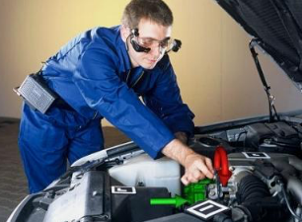
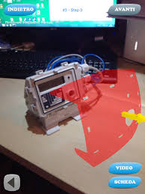
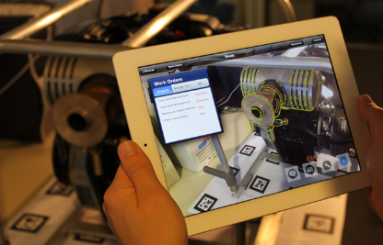
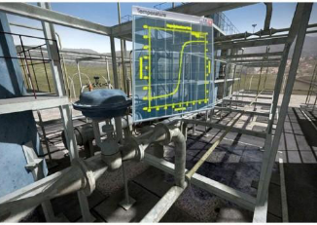
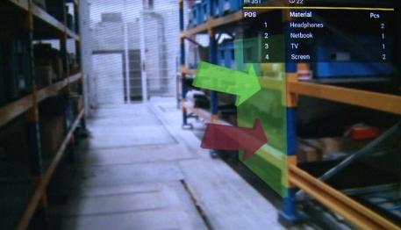
AUGMENTED REALITY (AR)
CYBER ENABLED PHYSICAL SYSTEMS

Slide 10

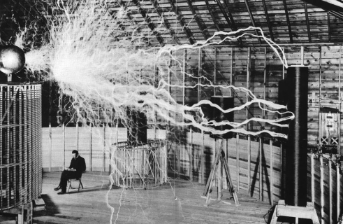
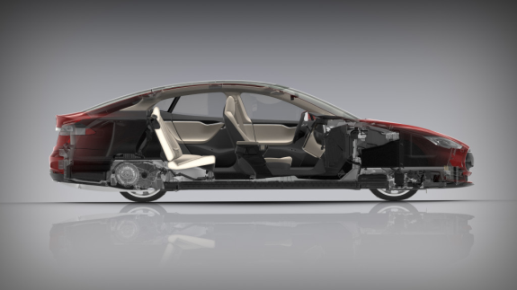
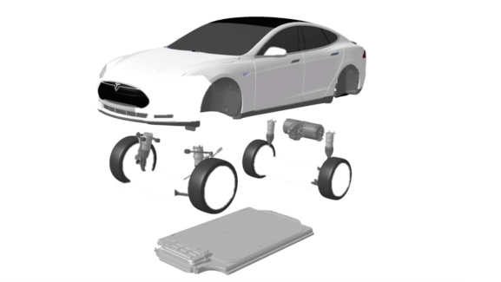
MACHINES OR COMPUTERS?
COMPLEX COMPUTER ON FOUR-WHEELS
Notes:
A Cyber-Physical System
At a computer expo (COMDEX), Bill Gates reportedly compared the computer industry with the auto industry and stated: "If GM had kept up with the technology like the computer industry has, we would all be driving $25.00 cars that got 1,000 miles to the gallon." The audiences agreed and applauded heartedly to this comment.
2010: on average 30% of cost is from electronics
2030: on average 50% of cost will be from electronics
Software sizes
Modern High-end Car: 100 million lines
FB: 62 million lines
Windows Vista: 50 million lines
Large Hadron Collider: 50 million lines
Boeing 787: 14 million lines

Slide 11
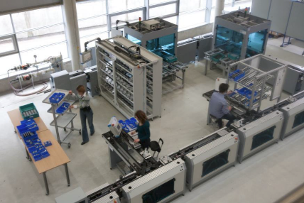
SMART MANUFACTURING THROUGH CPS AND DECENTRALIZED CONTROL
I’m booked out till Friday!
Solution Components
CPS
Self-configuration
Virtual representation
Context-aware
Information management
I have to be at the goods issue in 2 hours!
Magazine will be empty soon, please refill!
I can work on Saturday.
Sorry, I’m not available on Saturday.
Benefits
Increased flexibility and agility
Coping with complexity
I need to go home now. Who can take over my orders?
New customer order: We need an extra shift on Saturday.
Source: http://www.ipa.fraunhofer.de/industrie-40_applikationszentrum.html
Notes:
Human, Machines, Materials, AGVs, Products, etc.

Slide 12
ISA MULTI-LEVEL HIERARCHY OF ACTIVITIES
Level 4
Business Planning and Logistics (ERP)
Establishing the basic plant schedule - production, material use, delivery and shipping.
Determining inventory levels.
(Plant Production Scheduling, Operation Management, etc.)
Time Frame: months, weeks, days
Level 3
Manufacturing Operations Mgmt (MES, LIMS)
Work flow, recipe control to produce the desired end products.
Maintaining records and optimizing the production process.
(Detailed Production Scheduling, Dispatching Production, Reliability Assurance, etc. )
Time Frame: days, shifts, hours, minutes, seconds
Level 2
Batch
Control
Continuous
Control
Discrete
Control
Monitoring, supervisory control and automated control of the production process.
Time Frame: minutes, seconds
Level 1
Sensing the production process and manipulating it.
Time Frame: minutes, seconds, milliseconds
Level 0
The actual production process.
Time Frame: minutes, seconds, milliseconds

Slide 13
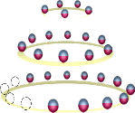
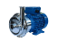


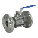
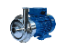


SERVICE-ORIENTED PLANNING OF FACTORY SYSTEM
ERP
MES
Field Layer
Factory System Planning independent to Hardware
Abstract Service
Independent to hardware
Library Services
Device Control
dependent to hardware
Sensor
Service
Gate
Service
Pump
Service
Control
Service
Communication Service
Source: Wolfgang Wahlster, DFKI, Germany
Notes:
Industry 4.0: All-IP Factories, no chaos of field buses, Internet-based Factory Networking based on IoS and IoT
Factory System Planning independent to Hardware
Based on IOT & IOS all IP Internet Factory

Slide 14
DYNAMIC PLANNING BASED ON SERVICE COMPOSITION IN AN SOA ARCHITECTURE
Green Production Minimize CO2
Highest Priority
Abstract Process Specification
Plug&Play
Conveyor 1. transport (lowSpeed)
Pick&Place.
insertBottom
(AssemblyPlace4)
Pick&Place.
insertBoard
(AssemblyPlace4)
Pick&Place.
insertCap
(AssemblyPlace4)
Assembly&Place4.
compress
Source: Wolfgang Wahlster, DFKI, Germany

Slide 15
CNC Machine
Machine 1
Active Semantic
Product Memory
M2M
Communication
Machine N
Active Semantic
Product Memory
M2M
Communication
…
…
Production Service Discovery, Matching and Execution
…
…
Workpiece Carrier 1
Active Semantic
Product Memory
Workpiece Carrier N
Active Semantic
Product Memory
SERVICE-ORIENTED
CPPS
Production Path Planning Based on Semantic Product Memories
…
…
Emerging Product 1
Active Semantic
Product Memory
Emerging Product N
Active Semantic
Product Memory
Semantic Product Memory
Top Shell Selection
Circuit-Top Shell Packaging
RES-COM Engravature
Top and Bottom Shell Assembly
Source: Wolfgang Wahlster, DFKI, Germany

Slide 16
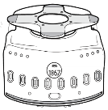
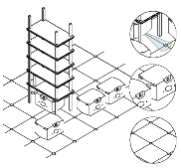
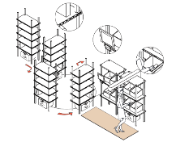
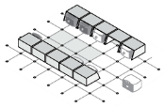
AMAZON AUTOMATED AGV: KIVA
Simple Mode
Black Tip for Grip
Move Pods to warehouse operator’s work station, reduce the 15 miles to 0 for walking for operators. Eliminate the fatigue factor, and increase the efficiency. Precision and highly ordered in the warehouse lower the cost for huge supplies.
Metallic Corkscrew Lifter
2’6”
Power Button
Machine Vision
Label & Series
1’
Ventilation
Rubber Strip
360 Rotation Wheels
2’2”
Highway System
The Kiva robots glide along the barcode gridded floor
Charging Station.
Every 2 or 3 hours, The robot get 15 minutes charging break
Product to Pick is marked by a Laser Pointer [Pick-to-light]
Packer scans Product
Light marks
designated box
[Pack-to-Light]
Camera underneath to read floor barcode
Camera on the sides to ensure minimum distance between two robots
Barcode sticker placed on the floor in a 40” x 40” grid
At each Packing Station
6-8 boxes can be packed simultaneously as the bots start queueing in a circular position
Notes:
Logistic environment for E-commerce is very different from traditional logistics environment, particularly on order picking
Industry 4.0 promises far-reaching payoffs for logistic operation. Industry 4.0 or so-called Productivity 4.0 in Taiwan refers to the technological evolution from embedded systems to cyber-physical systems (CPS) [1]. Put simply, Industry 4.0 represents the coming fourth industrial revolution on the way to an Internet of Things, Data and Services (figure 1) [2].

Slide 17


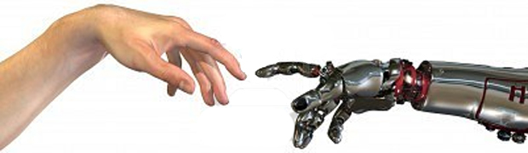
COLLABORATIVE ROBOTS
Human-Robot Cooperation
Dexterity
Power
Flexibility
Endurance
Problem Solving
Precision
Notes:
The Strength of Humans are Weakness of Robots and The Strength of human are the Strength of Robots
DEXTERITY 靈巧
ENDURANCE 耐力

Slide 18
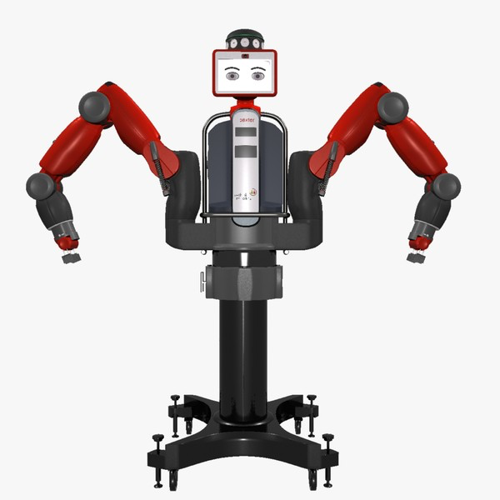
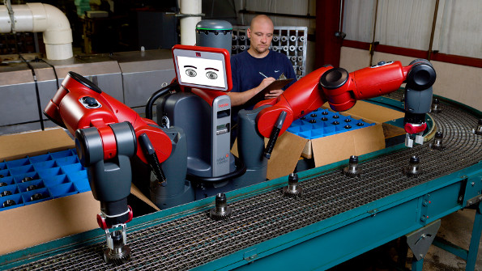
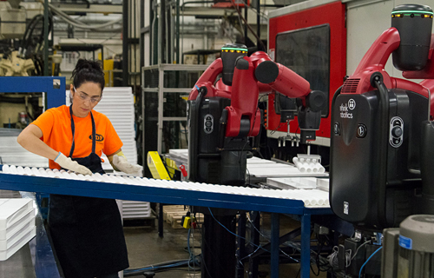
Collaborative/Cloud Robots
No integration
No programming
Work intelligently
No need to be in the cage
Robot OS: extendable platform
Cloud robot
Source: Rethink Robotics
Notes:
Cloud Robots

Slide 19


HUMAN-CENTERED CPS-BASED ASSISTANCE SYSTEMS
Physical Assistance by Exoskeletons
Context-adaptive
Assistance for
Fault Diagnosis
Mobile, Personalized,
Situation-Adaptive,
Tutoring Systems
AR/VR/DR Assistance in Complex Work
Processes
Multimodal
Human-Machine
Interaction
Location-based Maintenance and Planning Assistance

Slide 20


SOFTWARE ROLE IN INDUSTRY 4.0
Today INDUSTRY 3.0
App Store for Smart Factories
Tomorrow INDUSTRY 4.0
Source: Wolfgang Wahlster, DFKI, Germany

Slide 21

BIG DATA ANALYTIC TOOLS
Unsupervised Learning
Hadoop
Hive
Vertica
SciPy
Social Media Analytics
Map Reduce
Mahout
Sentiment Analysis
Esper
MATLAB
DATA MANAGEMENT
DATA ANALYSIS
DATA INSIGHT
Revolution R
Predictive Modeling
KDB
AMPL
BPO
BI
Greenplum
ETL
Netezza
SPSS
Visualization
ECL
Teradata
SAS
Simulation
Terabytes
Petabytes
Exabytes
Zettabytes

Slide 22
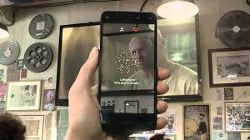
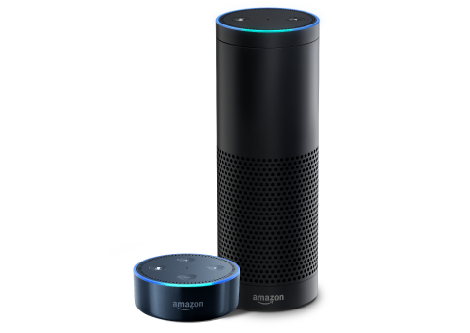

MACHINE LEARNING
Vision and Voice

Slide 23






INDUSTRIAL INTERNET EFFECT
INDUSTRY
IMPROVE
ANNUAL EFFECT
AVIATION
HEALTH
ENERGY
OIL & GAS
TRAIN
1% FUEL
$2 – 3 B
1% EFFICIENCY
$4 – 5 B
1% FUEL
$5 – 7 B
1% EFFICIENCY
$4 – 5 B
1% EFFICIENCY
$5 – 7 B
Source: GE

Slide 24
PREDICTIVE MAINTENANCE
Small items
Non-critical
Inconsequential
Likely to fail
Redundant
Subject to wear-out
Consumable Replacement
Failure pattern known
REACTIVE
PREVENTIVE
Reliability
Centered
Maintenance
Root Cause Failure Analysis
Age Exploration (Preventive Maintenance Optimization)
Failure Modes and Effects Analysis (FMEA)
Random failure patterns
Not subject to wear out
Preventive maintenance induced failures
PROACTIVE
PREDICTIVE
Notes:
Evidence-based Medicine
Descriptive Analysis
Predictive Analysis
Prescriptive Analysis

Slide 25
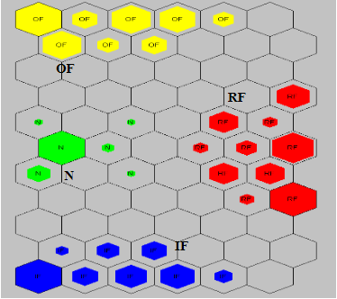
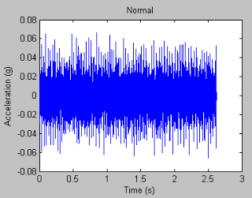
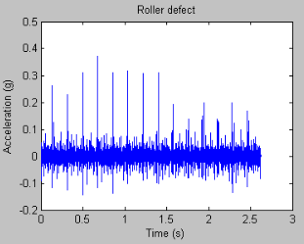
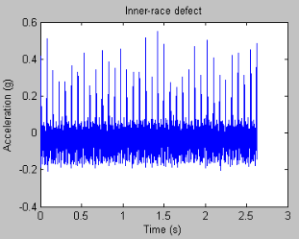
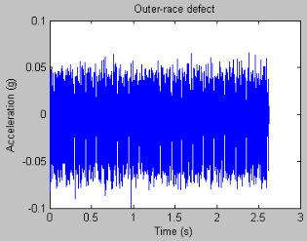
BEARING FAILURE DIAGNOSIS
Data Collection
Feature Extraction and Selection
(FFT)
Health Assessment & Fault Diagnosis
(SOM)
Normal
Roller
Inner Race
Outer Race
OF
RF
N
IF
Vibration signals for different bearing situations
Notes:
Data Collection
An accelerometer is installed on the vertical direction of bearing housing
A current sensor is installed to monitor one current phase of the spindle motor
The current signal is used as a time stamp to synchronize the obtained vibration data with the running speed of the shaft
PCM3178-HG-B DAQ is used as data acquisition hardware
Data is acquired through in-house software in the Watchdog Agent, which consists of computational health assessment and prognostic algorithms and a software toolbox for assessing and predicting the degradation of services
Feature Extraction and Selection
By using the FFT algorithm, the vibration signal is translated from time domain into its equivalent frequency domain representation
The magnitude spectrum can be subdivided into a specific number of sub-bands. A sub-band is basically a group of adjacent frequencies.
The center frequencies of these sub-bands have already been pre-defined at the bearing defect frequencies such as; Ball Passing Frequency Inner-race (BPFI), Ball Passing Frequency Outer-race (BPFO), Ball Spin Frequency (BSF) and Foundation Train Frequency (FT)
The feature vector that describes the health state of a bearing is: (energy around the bearing defect frequencies, amplitude peak at 1X RPM, amplitude peak at 2X RPM, amplitude peak at 3X RPM, acceleration maximum, RMS, kurtosis)
Health Assessment & Fault Diagnosis
With available data from different bearing failure modes, the SOM can be applied to provide a health map in which different regions indicate different defects of a bearing. Each input vector will be represented by a BMU (best machining unit) in the SOM
After training, the input vectors of a specific bearing defect are represented by a cluster of BMUs on the map, which forms a region indicating the defect. If we label the input vectors, we can define the defect that each region represents.
In this case, vibration data was collected from an experiment in which three bearings are artificially made to have a roller defect, an inner-race defect and an outer-race defect respectively. Vibration data is also obtained from a bearing with no defect.
After training the SOM, a health map for the classification of different bearing failure modes is obtained

Slide 26

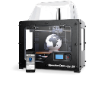





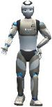
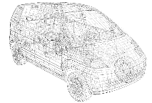
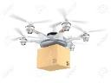
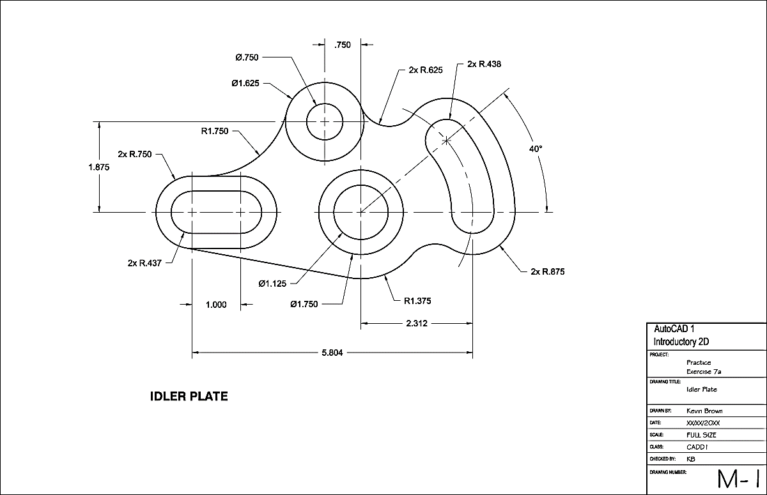

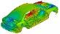

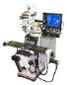

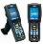

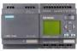




DIGITAL MANUFACTURING EVOVLUTION
Logistics
Sales
Sales
Logistics
Field Support
Marketing
Support
Purchasing
High
Production
Design
Logistics
Collaborative PLM
Marketing
Field Support
Marketing
Purchasing
Production
3D Printers
Tablet/Apps
Design
Procurement
Marketing
Full Digital Mockups
Purchasing
Production
Design
Purchasing
3D Solid Model CAD
Product Rendering
Production
Wearable
Humanoid Robots
Digital Ubiquitous Level
Design
Production
3D Wireframe
CAD/CAM
VR Visualization
Design
Stress Analysis
Collaborative 3D Design & Content Portals/Archiving
Drone Logistics
2D Drafting CAD
Programmable Logic Controllers
CNC/Robots
Rapid Prototyping
RFID Tracking
Ruggedized devices
Social Media
MRP/EDI
MRP II/EDI
Web Portals & Intranets
ERP, CRM, EDI
Design/Produce Automation
CAD/CAM
Electronic Product Definition
Digital Model &
Collaborative Design
Collaborative PLM & Cloud Linked E-commerce
Low
1970
1980
1990
2000
2010
2020
Notes:
Digital Manufacturing and Design Innovation (DMDII)

Slide 27
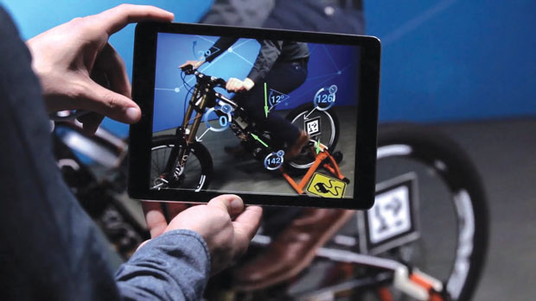
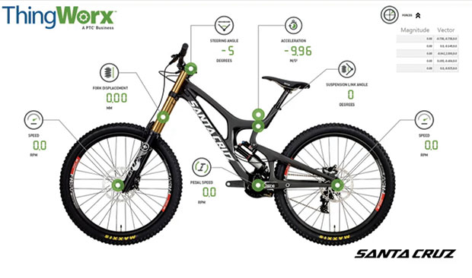
DIGITAL TWIN AND PRODUCT DESIGN
Digital Twin
Avatar
Notes:
Digital Thread

Slide 28
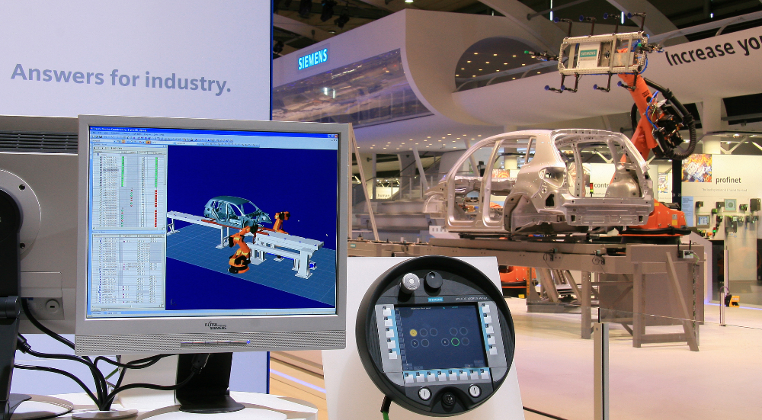
DIGITAL MANUFACTURING
Virtual Simulation
Augmented Reality

Slide 29

DIGITAL TWIN
Source: http://www.fastwayengineering.com/digital-twin/
Source: GE Look ahead Posted September 30, 2015
Source: http://www.gereports.com/
Source: http://www.gereports.com/

Slide 30








STANDARDIZATION, KEY IN INDUSTRY 4.0
Standardized by Semantic Description Language
Interface between Digital Cooperation and Digital Factories
IEC 62264
Semantic Service Description and Semantic Product Memory
OWL OWL-S OMM++ USDL WSDL
2860
7
6
5
4
3
2
1
SOA Services
SOA
Standardized by Interoperable Communication Standard
OPC UA
OPC-UA
IP
TCP/IP
Ethernet
RJ45, WiFi…
Electromechanic Layer Standard
HAN-Modular
Source: Wolfgang Wahlster, DFKI, Germany
Notes:
EN / IEC 62264 is an international standard for enterprise-control system integration.
VDI is the official abbreviation of the German Engineers' Association and 2860 refers to the guideline, which describes the prerequisites a machine needs to fulfil to be classified as a robot.
OPC: Open Platform Communication
When the standard was first released in 1996, its purpose was to abstract PLC specific protocols (such as Modbus, Profibus, etc.) into a standardized interface allowing HMI/SCADA systems to interface with a “middle-man” who would convert generic-OPC read/write requests into device-specific requests and vice-versa.
Supervisory control and data acquisition (SCADA) is a control system architecture that uses computers, networked data communications and graphical user interfaces for high-level process supervisory management, but uses other peripheral devices such as programmable logic controllers and discrete PID controllers to interface to the process plant or machinery.
A proportional–integral–derivative controller (PID controller) is a control loop feedback mechanism (controller) commonly used in industrial control systems. A PID controller continuously calculates an error value e(t) as the difference between a desired setpoint and a measured process variable and applies a correction based on proportional, integral, and derivative terms (sometimes denoted P, I, and D respectively) which give their name to the controller type.
OPC-UA: Unified Architecture
The OPC Unified Architecture (UA), released in 2008, is a platform independent service-oriented architecture that integrates all the functionality of the individual OPC Classic specifications into one extensible framework.
This multi-layered approach accomplishes the original design specification goals of:
Functional equivalence: all COM OPC Classic specifications are mapped to UA
Platform independence: from an embedded micro-controller to cloud-based infrastructure
Secure: encryption, authentication, and auditing
Extensible: ability to add new features without affecting existing applications
Comprehensive information modeling: for defining complex information
Functional Equivalence
Building on the success of OPC Classic, OPC UA was designed to enhance and surpass the capabilities of the OPC Classic specifications. OPC UA is functionally equivalent to OPC Classic, yet capable of much more:
Discovery: find the availability of OPC Servers on local PCs and/or networks
Address space: all data is represented hierarchically (e.g. files and folders) allowing for simple and complex structures to be discovered and utilized by OPC Clients
On-demand: read and write data/information based on access-permissions
Subscriptions: monitor data/information and report-by-exception when values change based on a client’s criteria
Events: notify important information based on client’s criteria
Methods: clients can execute programs, etc. based on methods defined on the server
Integration between OPC UA products and OPC Classic products is easily accomplished with COM/Proxy wrappers that are available in the download section.

Slide 31

MAPPING BETWEEN IIRA AND RAMI4.0
IIRA 3-tier functional viewpoint with the IT layers associated with the RAMI 4.0 architecture for the IDT and AE testbeds
Source: Interoperability between IIC Architecture & Industry 4.0 Reference Architecture for Industrial Assets, Infosys, 2016.
Notes:
IDT: Industrial Digital Thread
AE: Asset Efficiency

Slide 32
DEFINING INDUSTRY 4.0 FOR MANUFACTURING
Batch or Size of 1 Production: Flexible Mass Customization
Manufacturing Objective: Order Fulfillment
s.t.: Resource constraints (flexibility, agility)
Market constraints (individualization)
Environment constraints (low energy, over-production)
HR constraints
Enablers: CPS, IOT
Supporting technologies: big data, AI, digital manufacturing, cobots, Ux/UI, AR/VR, blockchain, DAS, APS, cloud/fog
Notes:
NOT Mass Production
Using CPS/ICT/IOT technologies to bring in intelligence, and thus flexibility and agility, to enable and empower production/manufacturing.
Meeting the maximum demand as the objective function to Maximizing conservation subject to demand satisfaction.
Digital Manufacturing: digital thread, digital twin and simulation
Steps:
Digital integration (IOT sensing and

Slide 33

CONSUMER/INDUSTRIAL IOT
Connecting CONSUMER Products
Revolutionary
Many new opportunities
Evolving from many isolated developments
Connecting INDUSTRIAL Products
Not new
With rich foundation from automation
… however, will be explosive

Slide 34





















SMART WATER DISPENSERS: A CPS
Hot water : 1100 Watt
(heated every 40 minutes)
Sensor
Predictive
Maintenance
User Analysis
Cold water : 245 Watt
(cooled every 30 minutes)
Inter-machine
Communication
Data Analytics
User Behavior
Or Usage Analytics
Demand Patterns and Operation Models
M2M Communication and Coordination
Predictive Maintenance
Usage Patterns as the basis for Water Preparation
3
Blockchain-supported
Anomaly
Detection and Consumable Replacement
Monitoring & Profiling
2
1

Slide 35

NEW PARADIGMS OF BUSINESSES
Source: "The coffee is free, but now we rent the tables." - New Yorker Cartoon, by Mick Stevens

Slide 36
EVOLVING BUSINESS MODELS
World’s largest consumer hardware company only creates few apps.
World’s largest accommodation provider that owns no real-estate.
World’s largest “taxi” company that owns no vehicle.
Notes:
Apple FY2015 revenue: http://revenuesandprofits.com/how-apple-makes-money/
$155.0 billion revenues, 66.3% of the total, from iPhone.
$23.2 billion revenues, 9.9% of the total, from iPad.
$25.5 billion revenues, 10.9% of the total, from Mac.
$19.9 billion revenues, 8.5% of the total, from Services. Services includes revenue from the iTunes Store, App Store, Mac App Store, iBooks Store, Apple Music, AppleCare, Apple Pay, licensing and other services.
$10.1 billion revenues, 4.3% of the total, from Other Products. Other Products includes sales of Apple TV, Apple Watch, Beats products, iPod and Apple-branded and third-party accessories.
Total $233.7 billion in FY’15
Asset owning business may not be the value you can hold on.
It is not making your business digital; it is making a digital business as

Slide 37








FROM PRODUCT TO SYSTEM OF SYSTEMS
System of Systems
Client Prediction
Product System
Dynamic Contact
Schedule Optimization
Connected, Smart Product
Shift Schedule System
Smart Product
Logistic Companies VMI
Baristas
Product
+
Coffee Machine System
Coffee Grinder
Coffee Machine System
Coffee Shop Biz System
Material Manage System
+
+
Coffee
Machine
Roaster
Stocking
Demand Prediction System
Coffee Machine Record
Weather
Activities
Source: (based on) Michael E. Porter and James E. Heppelmann, How Smart, Connected Products Are Transforming Competition, Harvard Business Review, Nov. 2014.

Slide 38
INDUSTRY INTERNET/IOT STAGES
As Industrial Internet blends into all industry, it will ultimately lead to PULL ECONOMY.
Autonomous Pull Economy
Keep Detecting Needs
End to End Automation
Optimize Resource & Reduce Waste
Outcome Economy
Pay-per-outcome
New wired Ecosystem
Platform contributed Market
New Product & Service
Pay-per-use
Software-based Service
Data Monetized
Efficiency
Application of Assets
Lower Cost
Productivity
Long Term
Short Term
System Characteristics include real-time demand detection; and highly automated, flexible production & fulfillment network.
Source: “Industrial Internet of Things: Unleashing the Potential of Connected Products and Services," World Economic Forum, 2015
Notes:
Outcome Economy
Pay-per-use
Pay-per-outcome

Slide 39





SECURITY AND PRIVACY
How blockchain transfers values
What is Blockchain?
It is a decentralized and distributed digital ledger that records transactions across many computers in such a way that the registered transactions cannot be altered retroactively
What is Blockchain Technology & Usage
A digital ledger that keeps a record of all transaction taking place on a peer-to-peer network
All information transferred via blockchain is encrypted and every occurrence recorded, meaning it cannot be altered
It is decentralised, so there is no need for any central, certifying authority
It can be used for much more than the transfer of currency. Contracts, records, and other kinds of data can also be shared
Notes:
This slide shows what is blockchain and how it works
This more about Blockchain further usage:
SHARING ECONOMY: Building trust on platforms like Airbnb
store people's online identities on the blockchain. That identity is then linked to reviews and scores on the sharing economy and other marketplace sites
ELECTRICITY MARKET: Letting houses generate and sell their own electricity
a distributed network, that built on blockchain's technology, lets people generate their own electricity to sell on the network, using blockchain's identifying tech to buy and sell to strangers
PROPERTY: Cutting admin costs by keeping records on the blockchain
put property records on the blockchain so that prospective buyers can quickly, easily, and cheaply verify that the owner of a house really does own the place
SECURITIES: Cut out errors, thereby reducing costs
the industry could save $11 - $12 billion in fees by using blockchain to the clearing and settlement of cash securities specifically, equities, repo, and leveraged loans
FINANCE: Improve​ anti-money laundering and "know your customer" checks
like with the Airbnb example, identity data stored on a blockchain that could help finance firms easily and quickly check new customers

Slide 40
FUTURE TECHNOLOGICAL ENVIRONMENT
IOT - liquefication of the physical world
Data - the new mines
Big Data Analytics - the new math
Blockchain - the new Internet of value and ownership
Computational Thinking
Bio - the new digital
Towards Outcome Economy and Pull Economy
Continuously evolving . . .
Notes:
Human and education aspects of the development?

